Slide 1
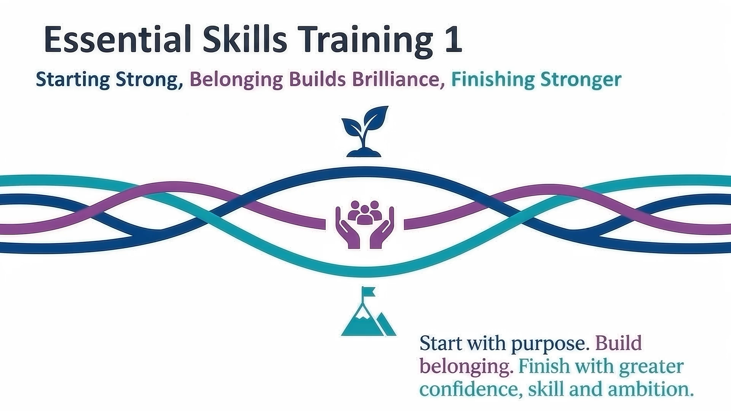
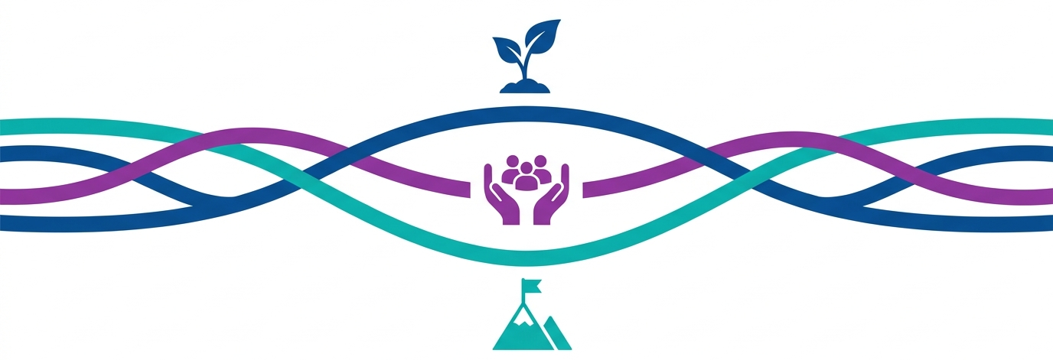
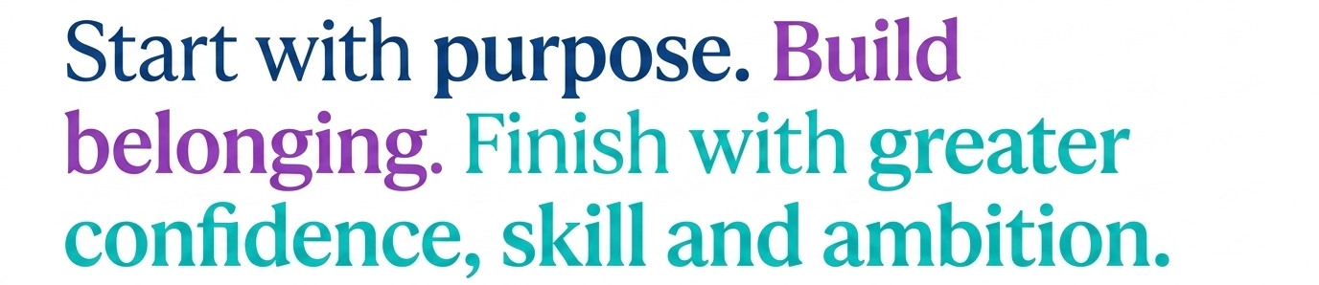
Essential Skills Training 1
Starting Strong, Belonging Builds Brilliance, Finishing Stronger

Slide 2
Essential Skills Training 1: Starting Strong and Finishing Stronger…
As you settle, think about:
What you understand by the term ‘Starting Stronger…’
(Lead: Dan Tagg)

Slide 3
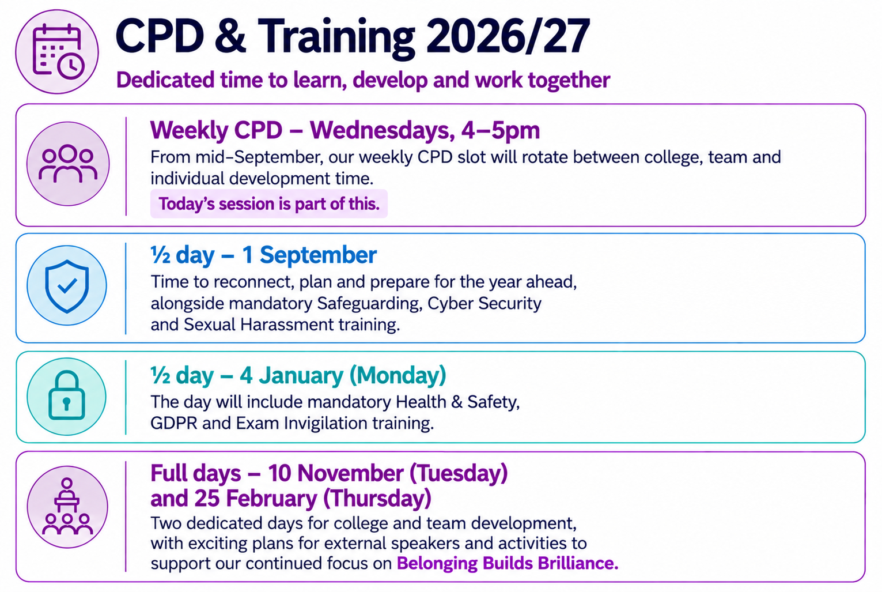
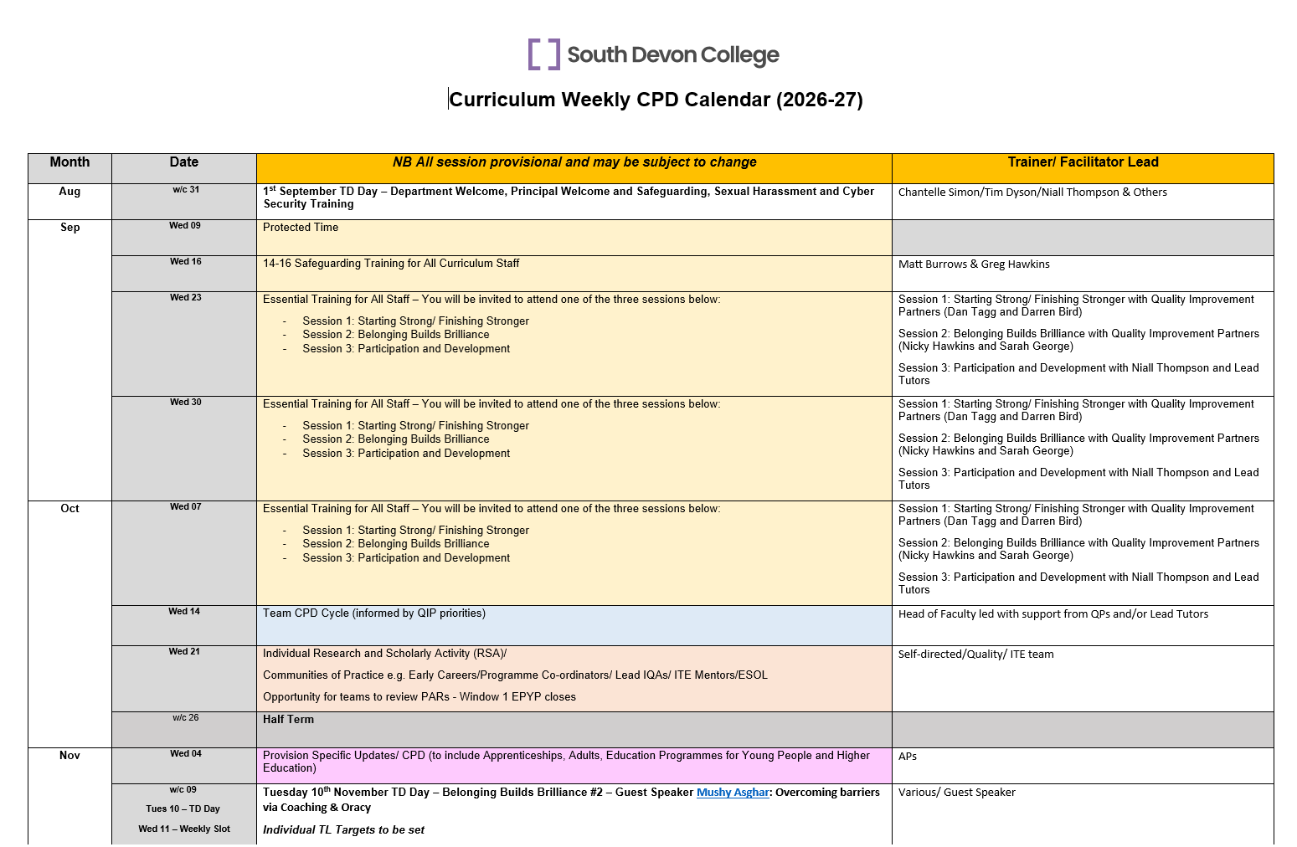
Looking forward… (Lead: Assistant Principal)
Click here for the full schedule

Slide 4


Slide 5
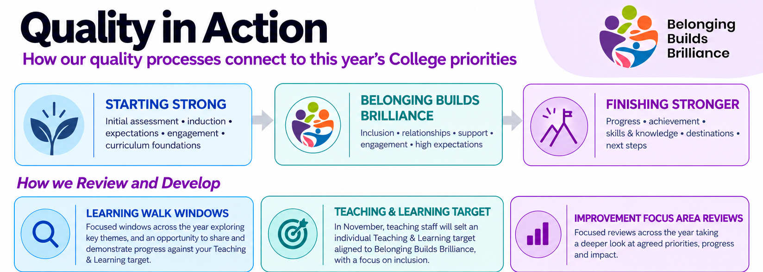

Slide 6
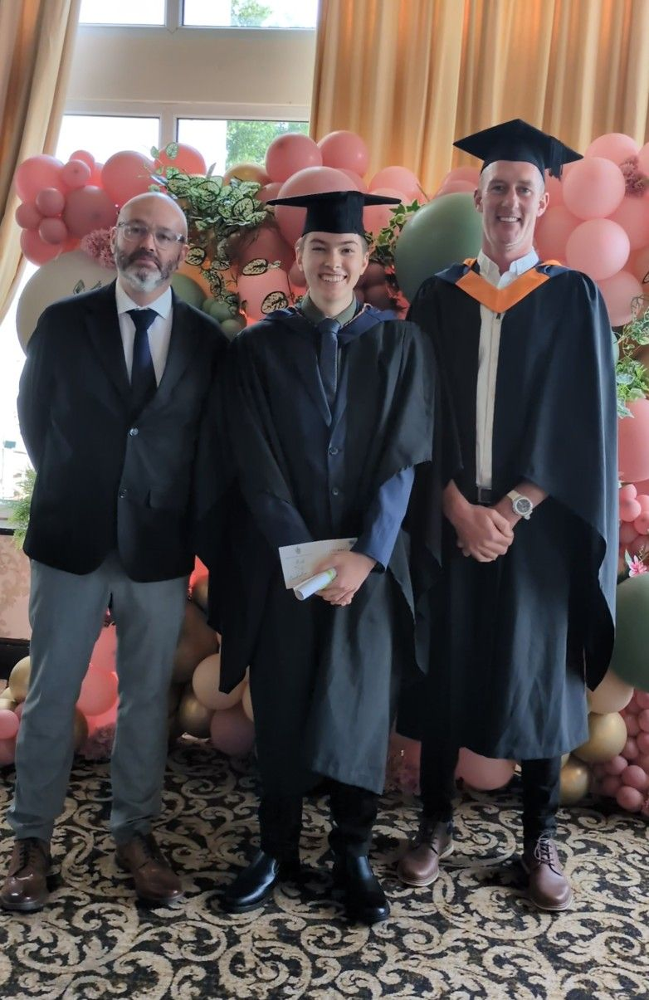
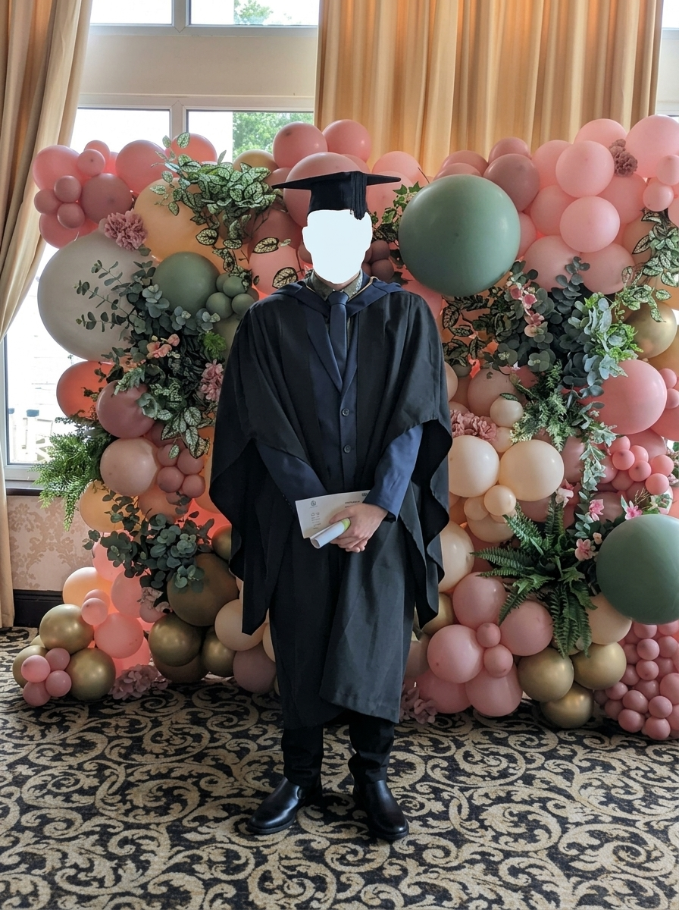

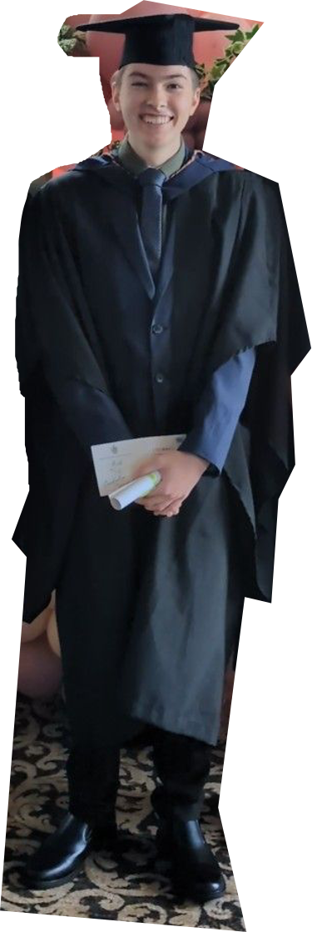
The Student Journey -
Hayden Bartlam (Phipps)
"Today is a day I once thought I could only imagine…
The last 6 years inside the South Devon College building have been an incredible adventure, starting at South Devon High School at 14, continuing through South Devon College, and now graduating with a degree from University Centre South Devon at 20 years old."
"Achieving this wasn't a solo effort!"

Slide 7

Session Outcomes &
Starter​ Question
Identify how you can ensure students and apprentices Start Strong & Finish Stronger​​
What do you understand by the term ‘Starting Stronger’?
(Lead: Dan Tagg)

Slide 8
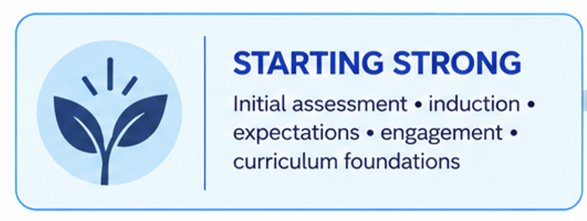
Starting Strong(er) – What is it?
Positive learner relationships?
Participation and development….
Notes:
What is missing??

Slide 9

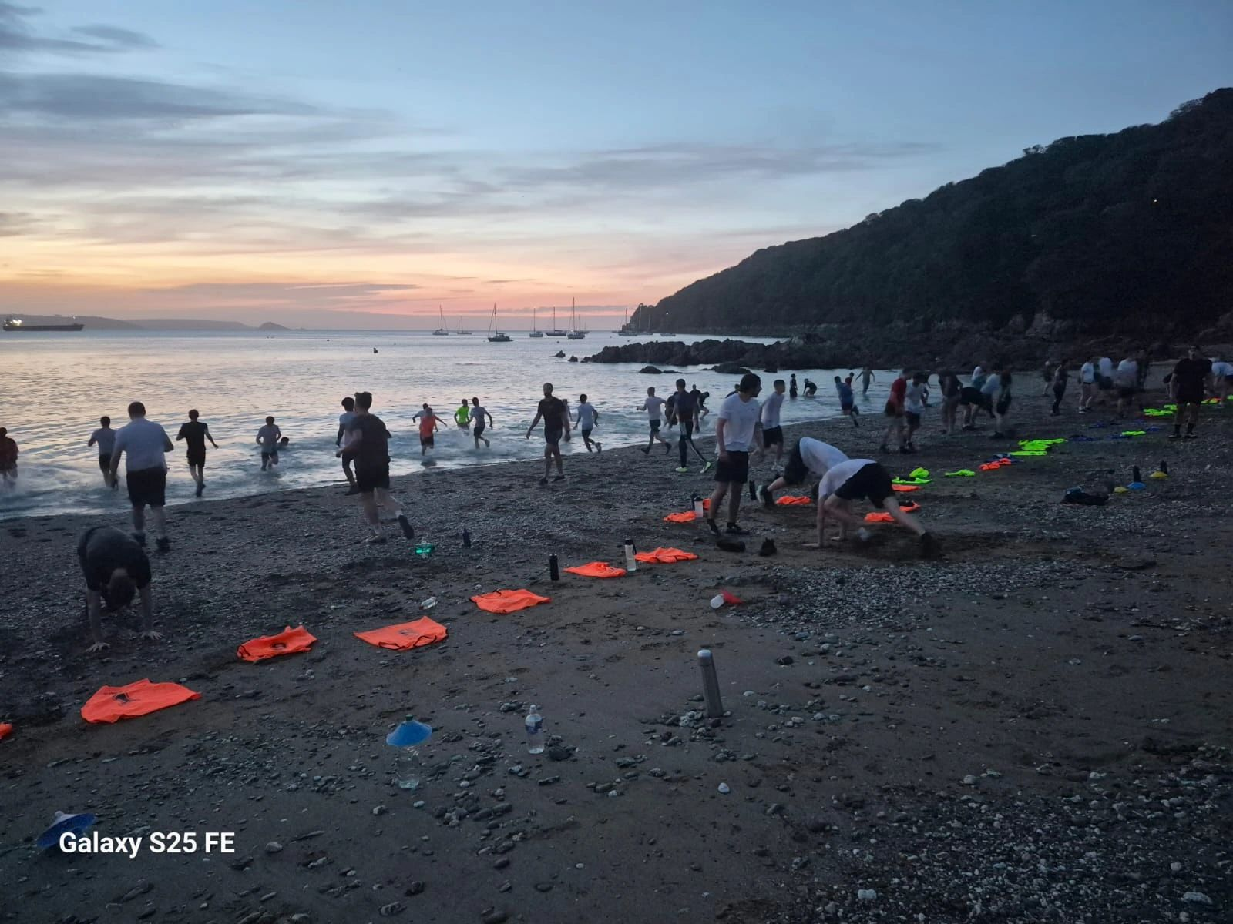
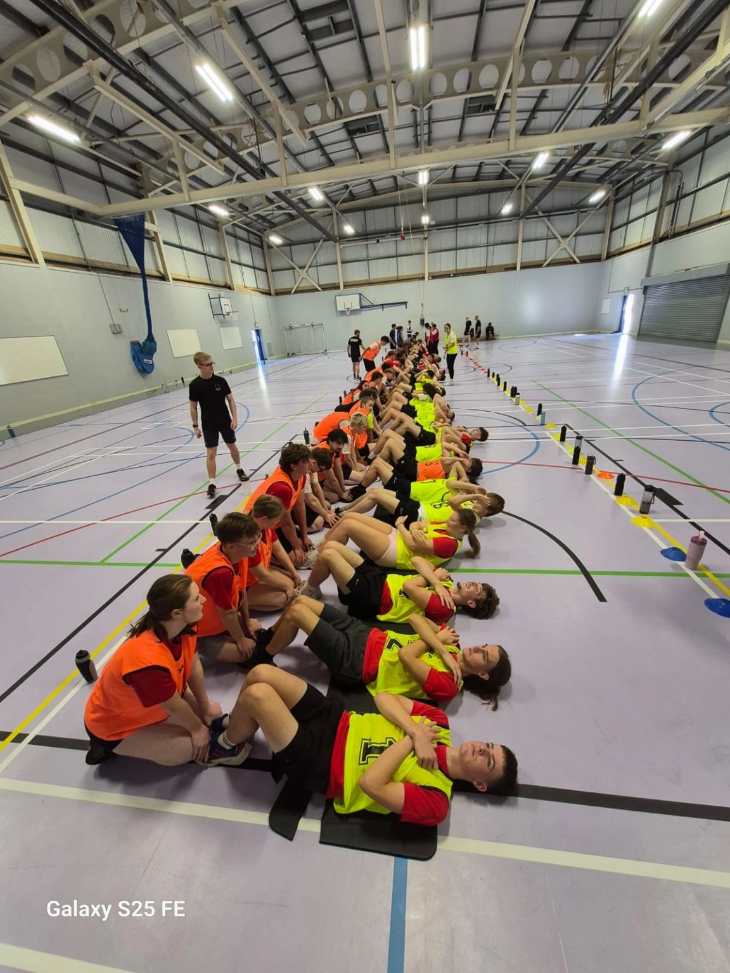
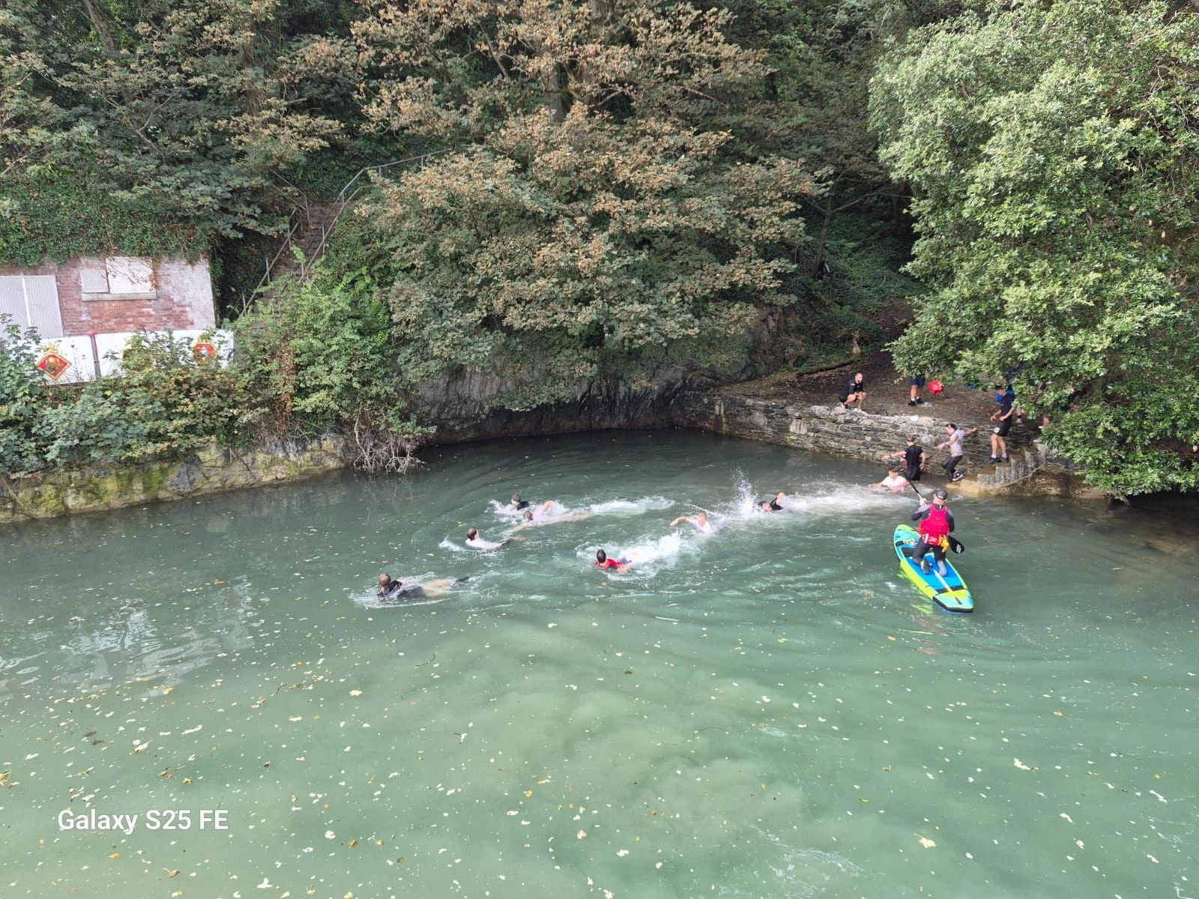
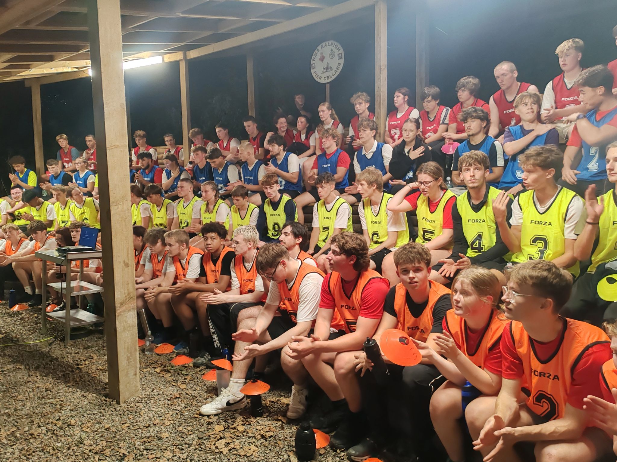
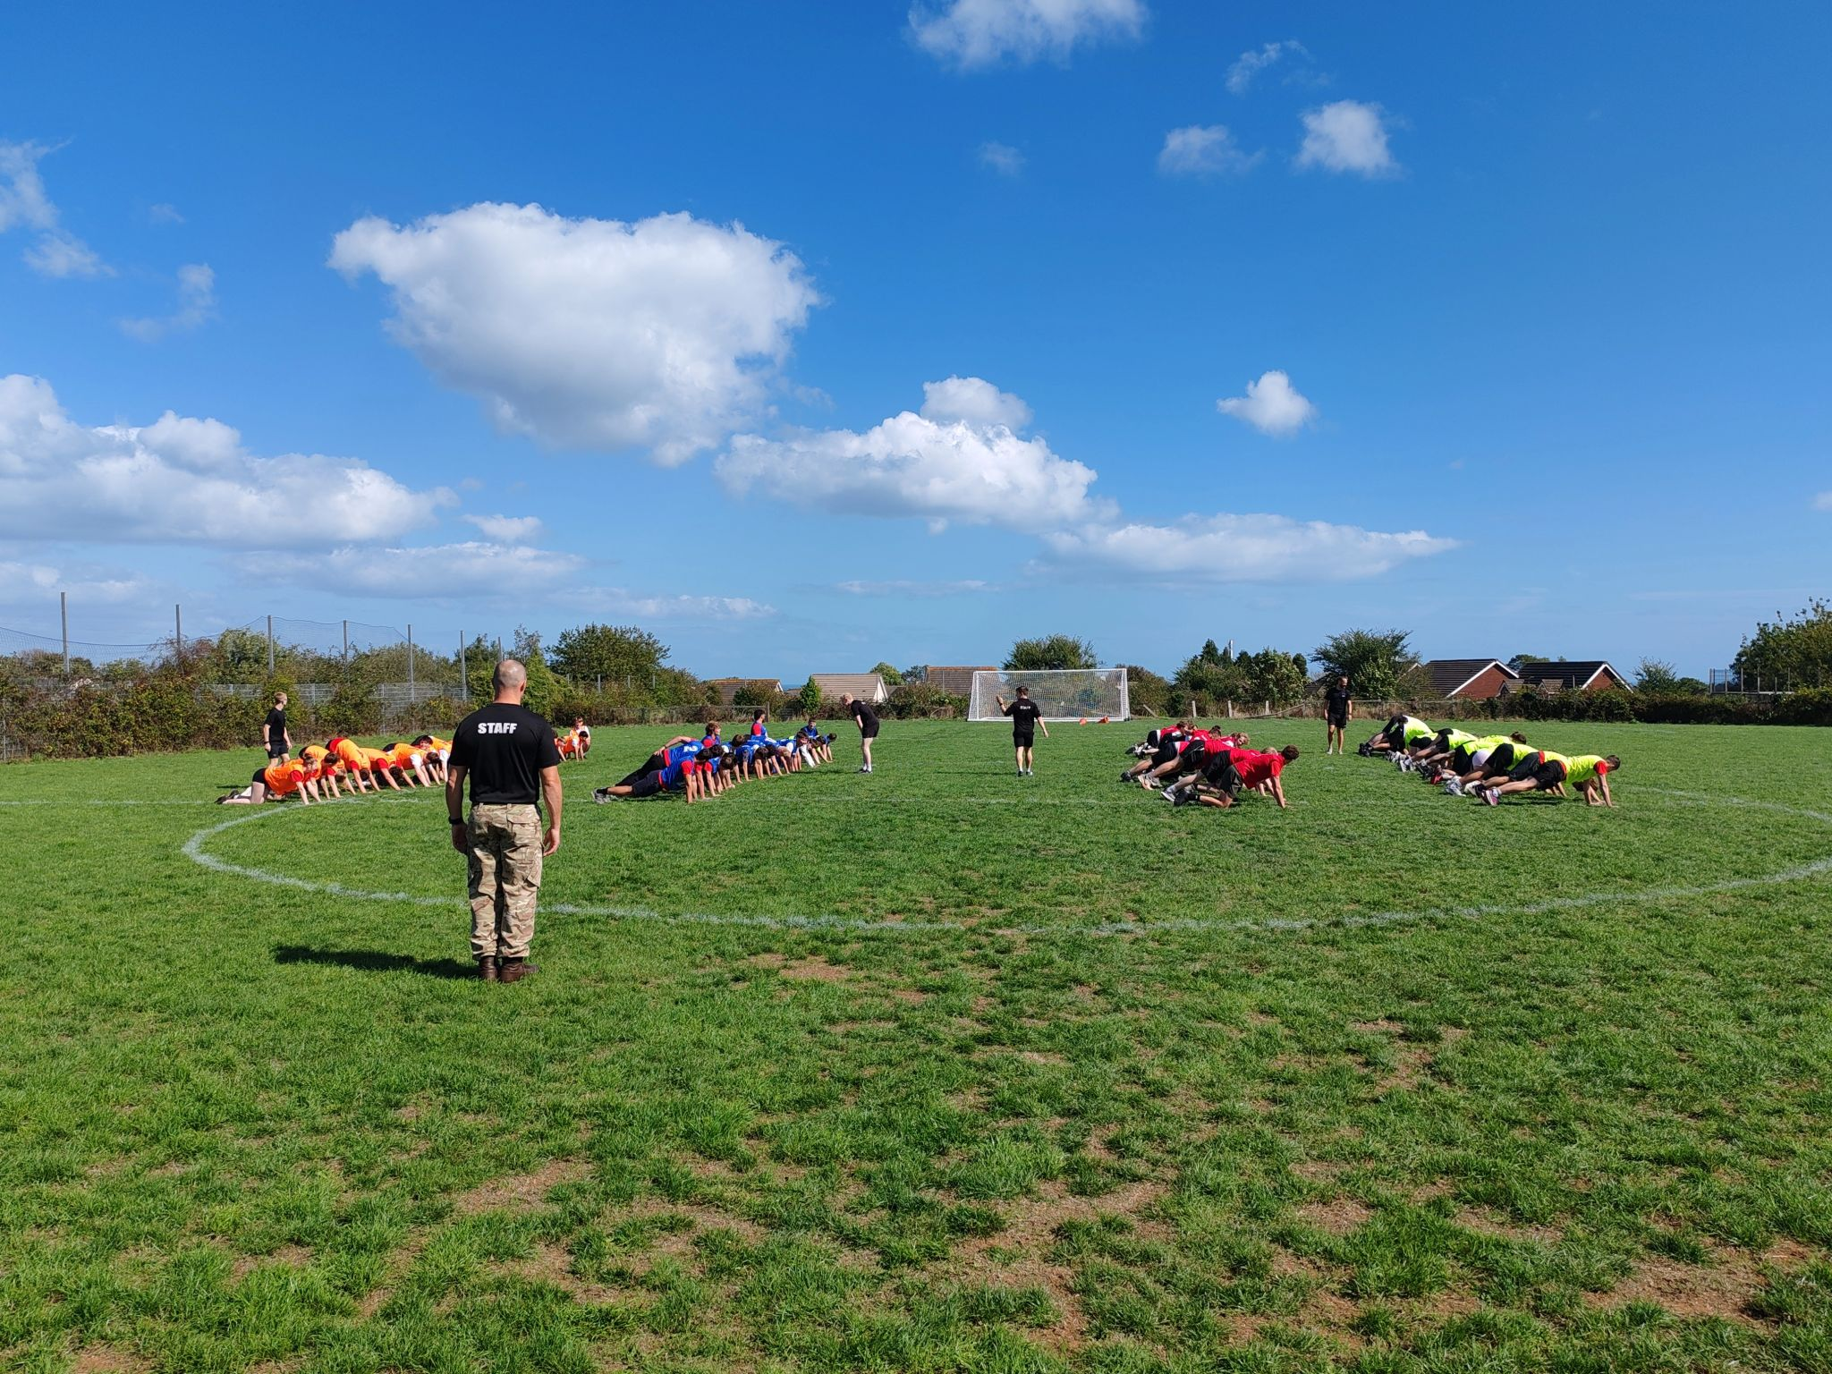
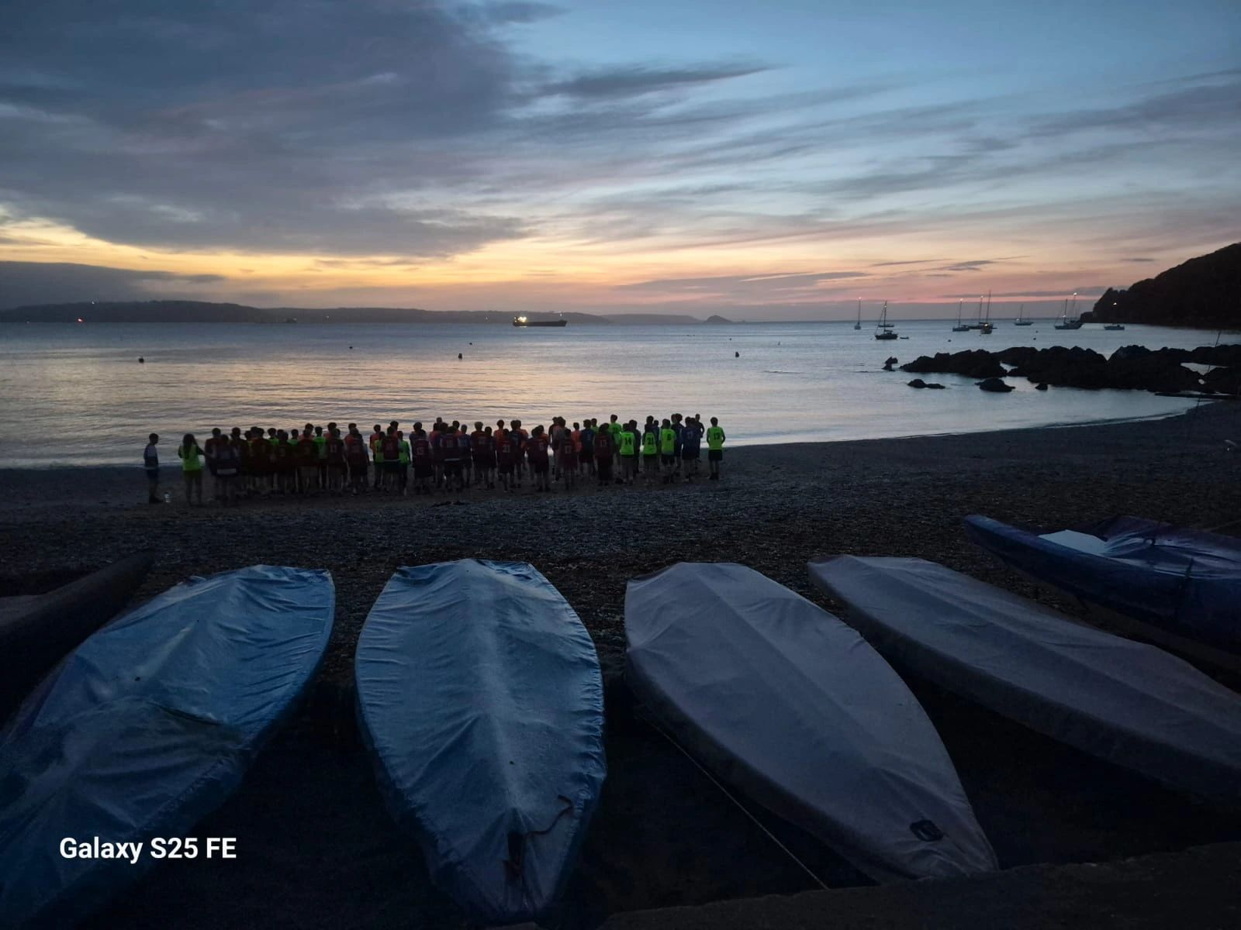
Starting Strong – A Snapshot…

Slide 10
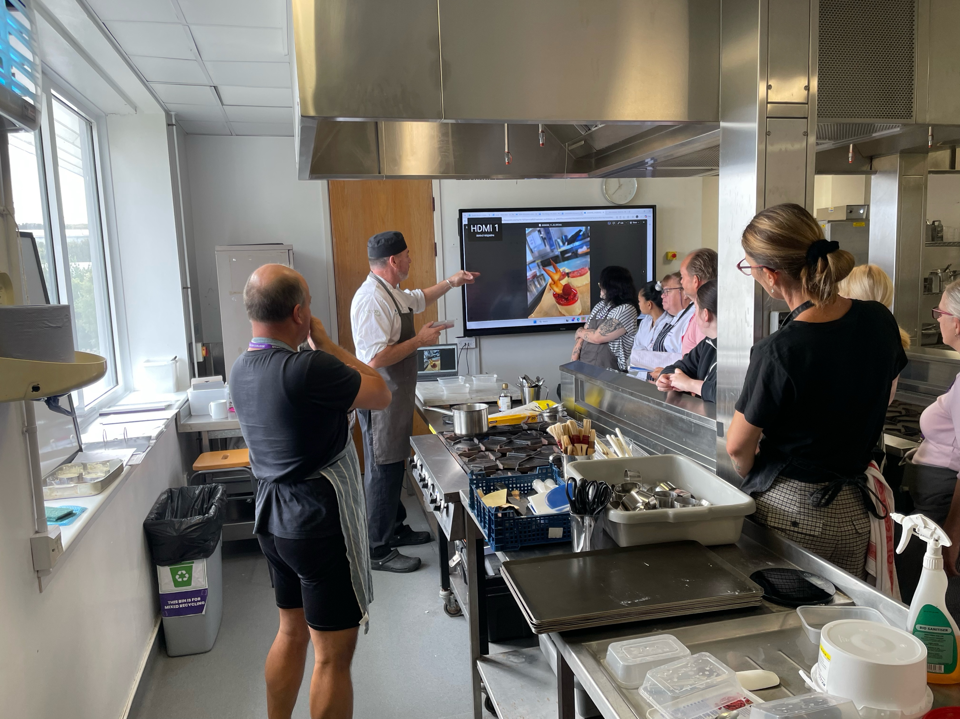
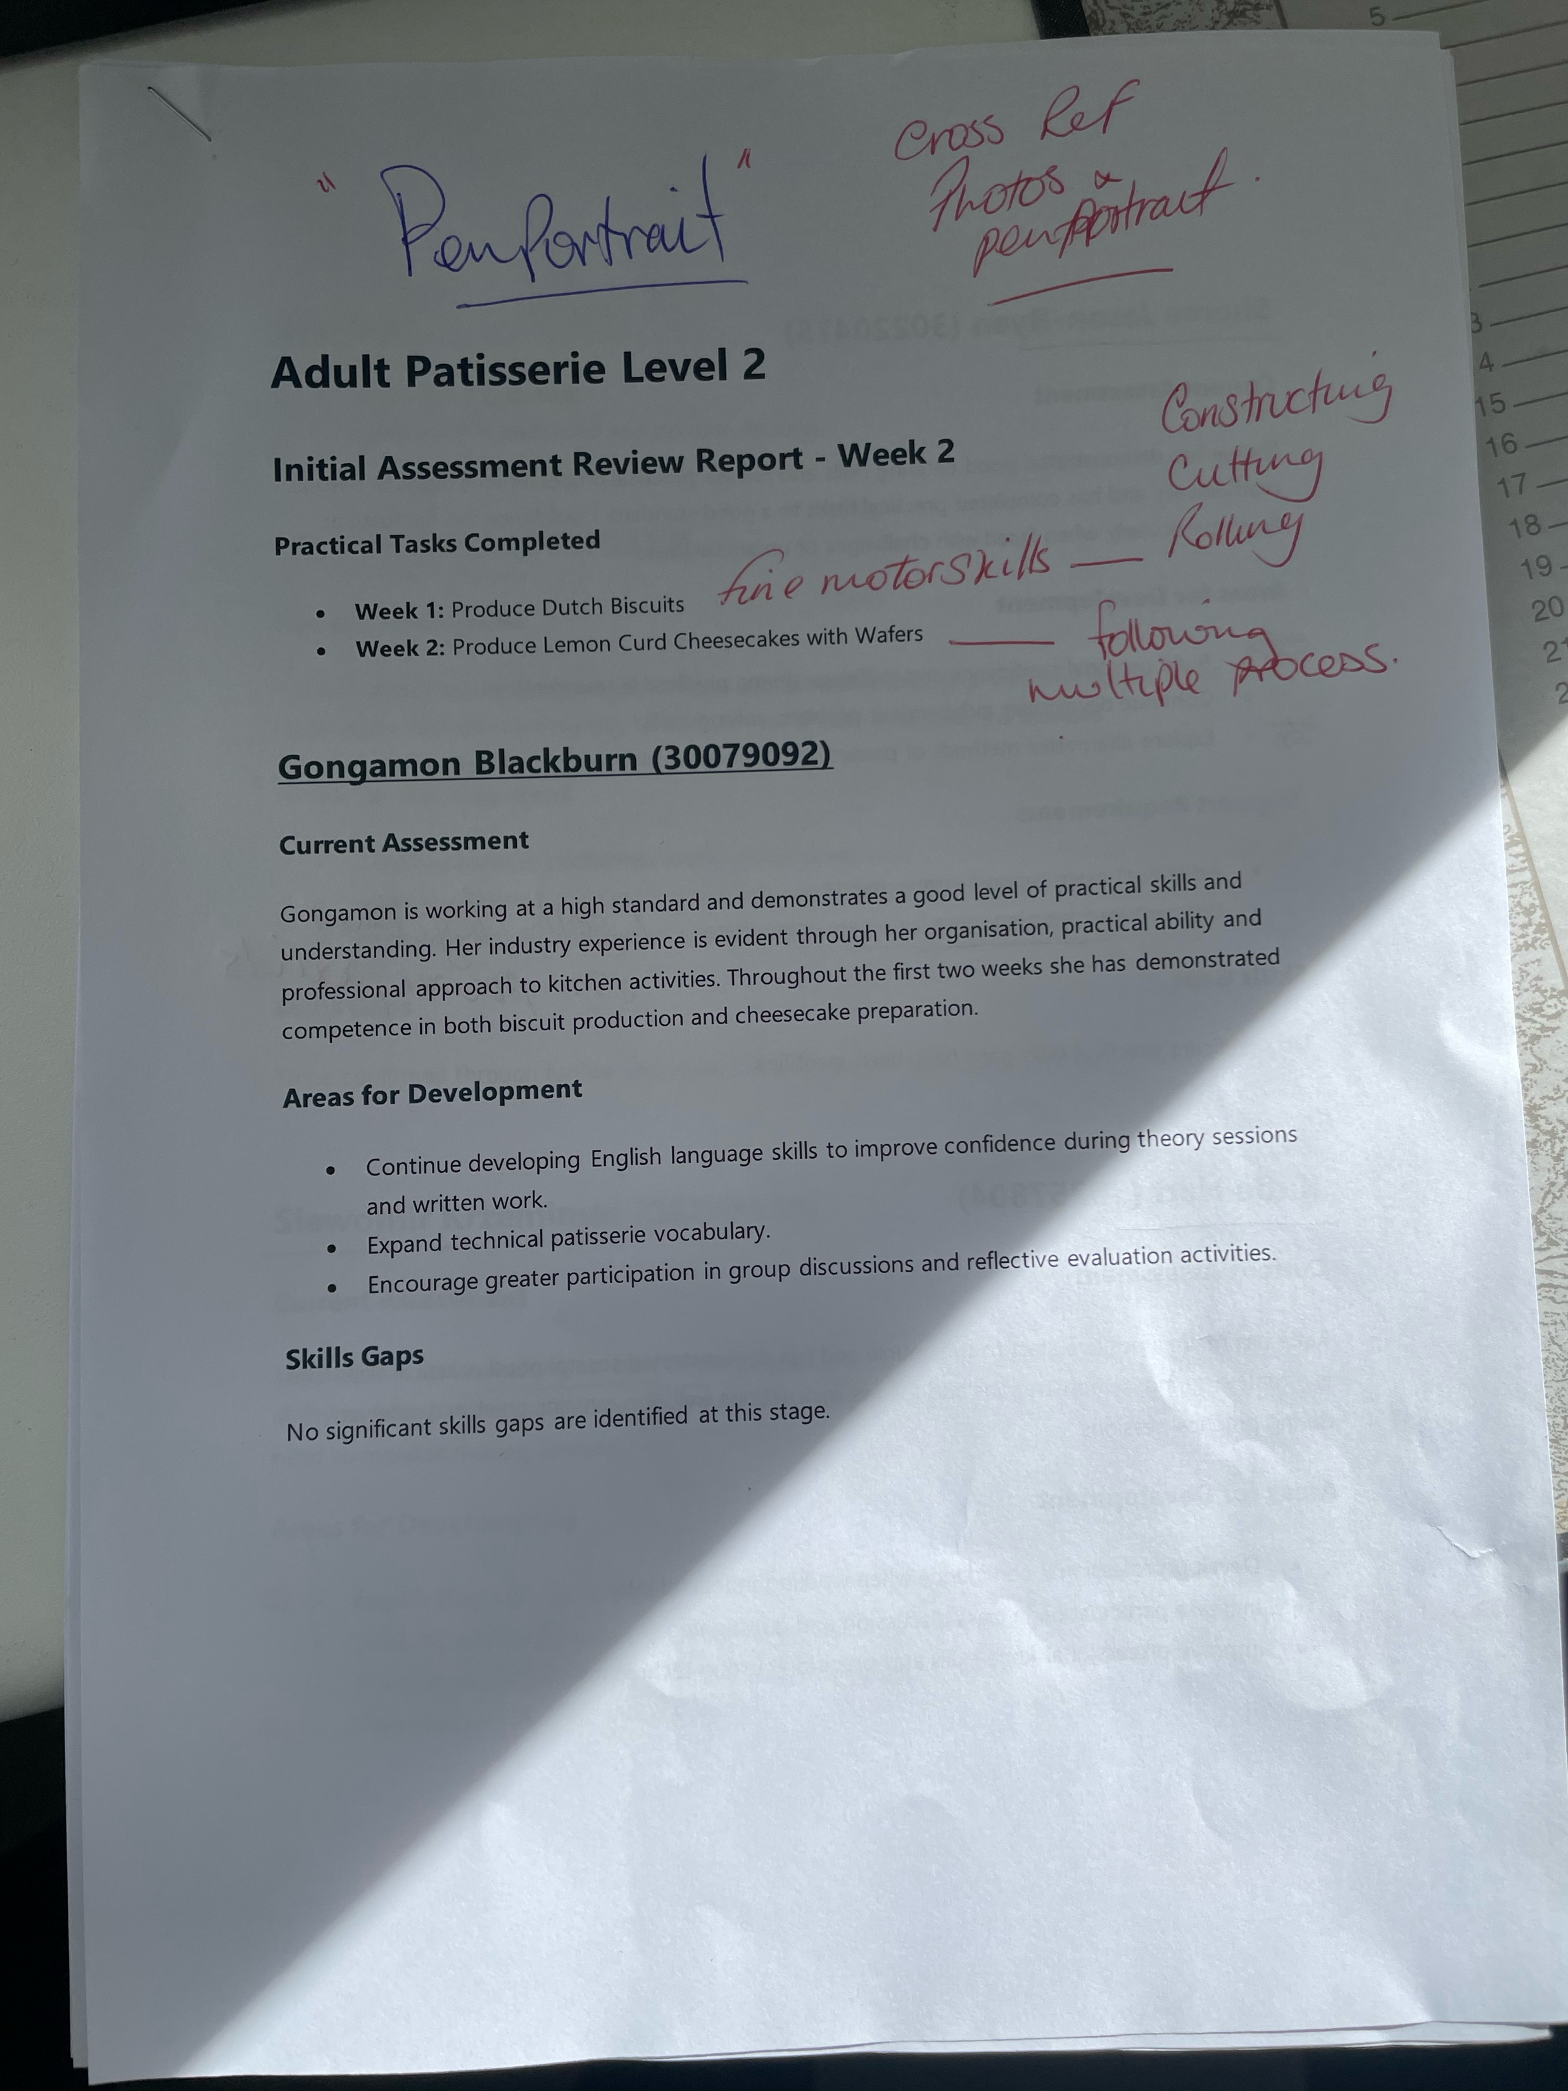
Starting Strong – A Be Great approach… 10/10
Evidence Learner Voice:
“The teachers are lovely. So that's Matt and David. I'm really enjoying the course.
I feel like I've found my career here. I feel like I want to do cheffing.”

Slide 11
Starting Strong – A Wider Perspective
Evidence:
"Starting points are identified but underused: Everybody uses the initial assessment but then not much is done with it afterwards once scores are recorded".
"Our initial assessment is actually their last assessment in schools."
Limited curriculum adaptation based on learner need: "We've got this baseline but we kind of ignore it and just teach what we teach."
South Devon Staff – Course SARs (2026)

Slide 12
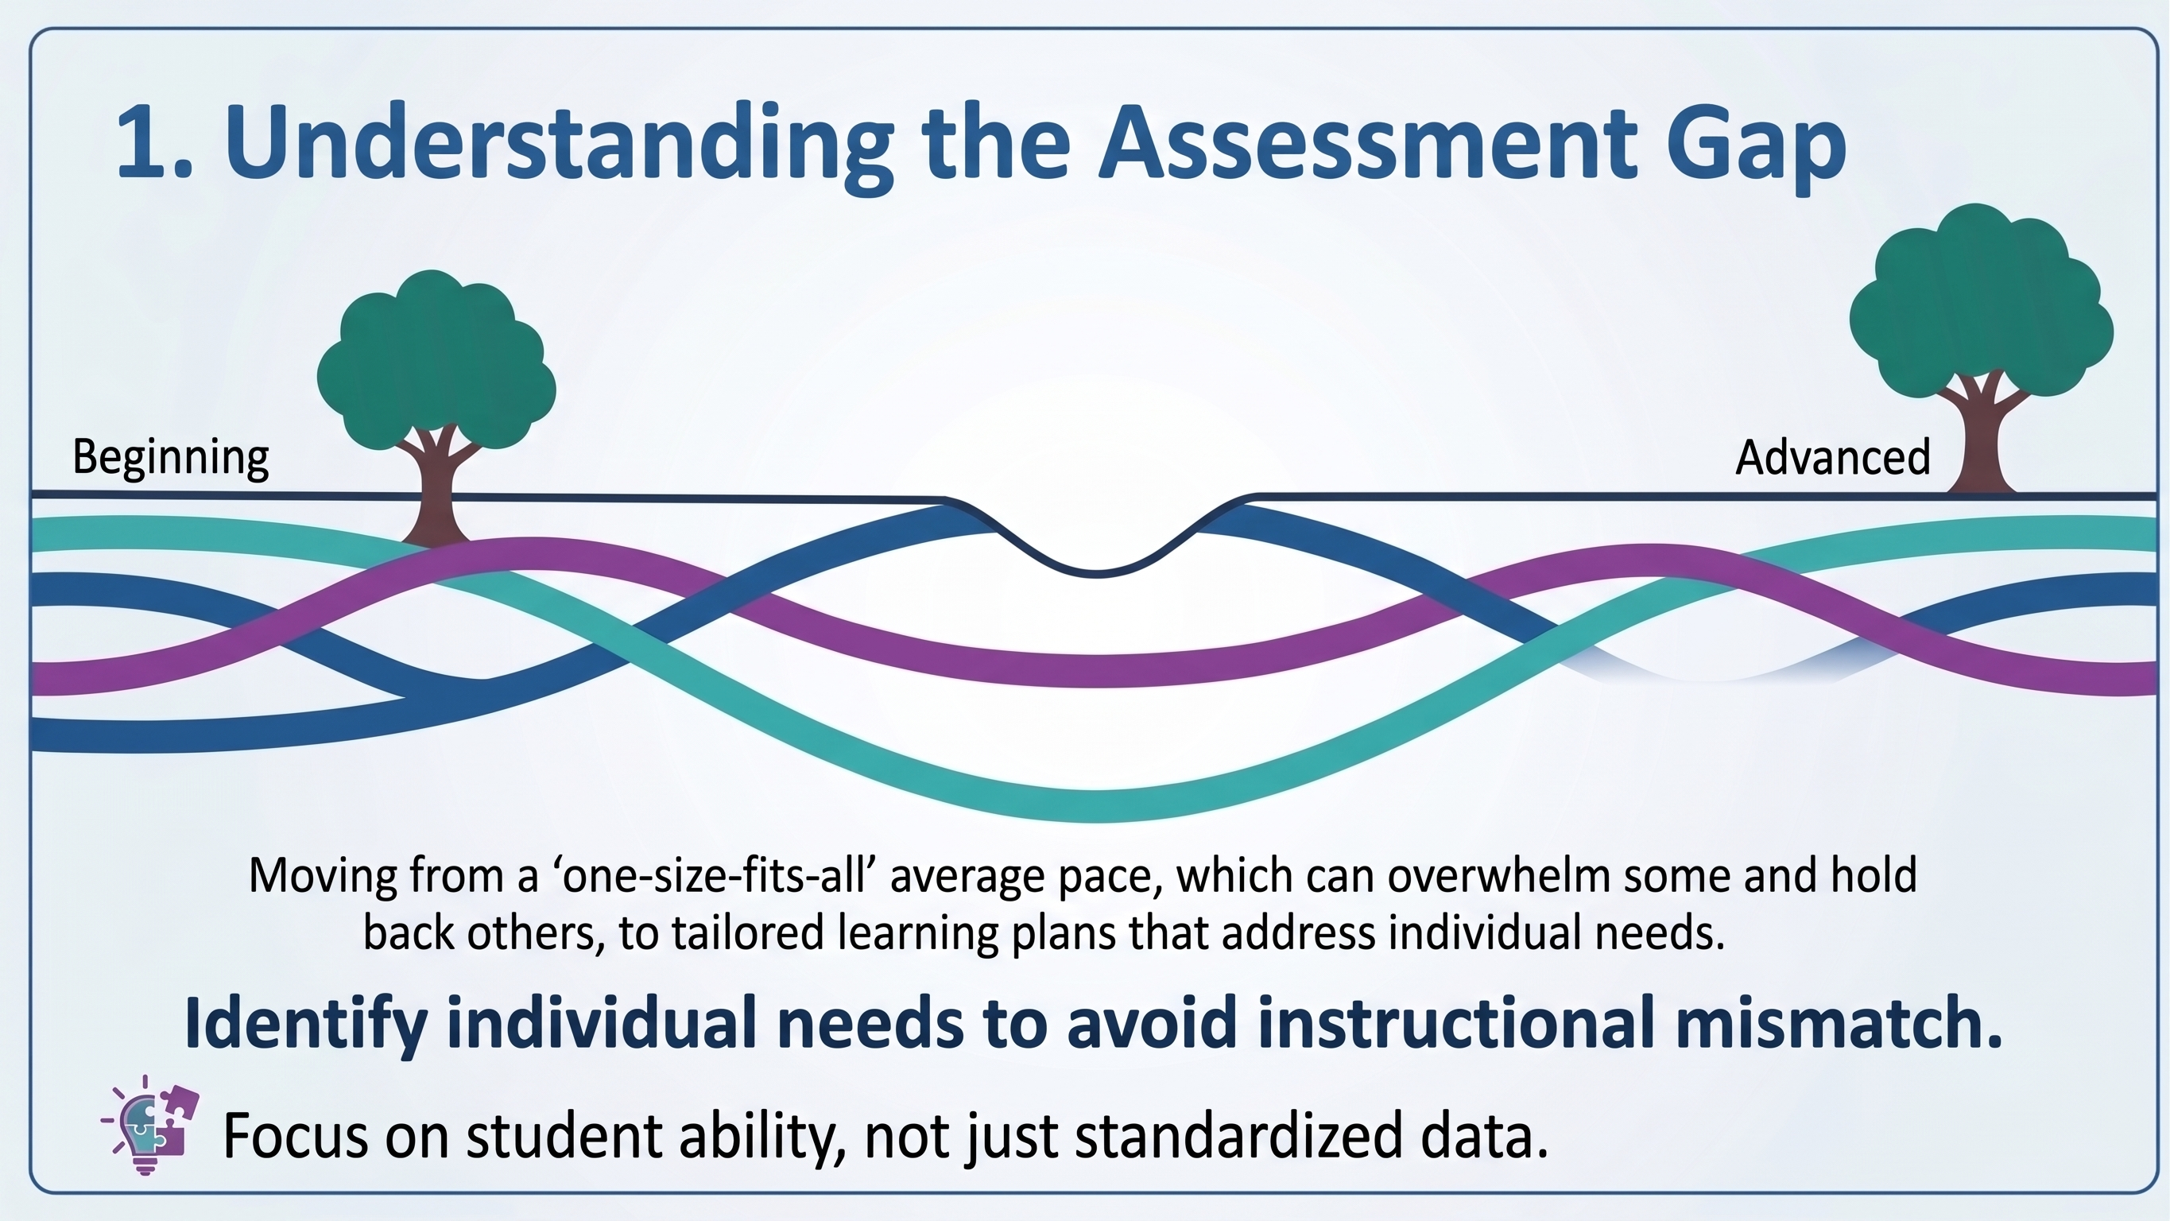
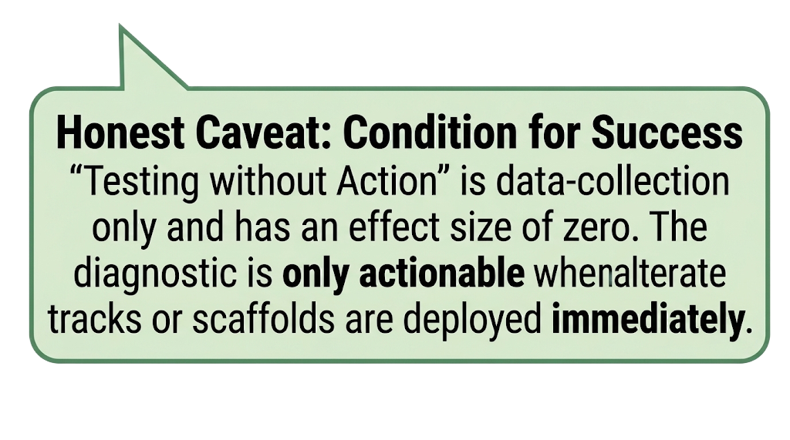
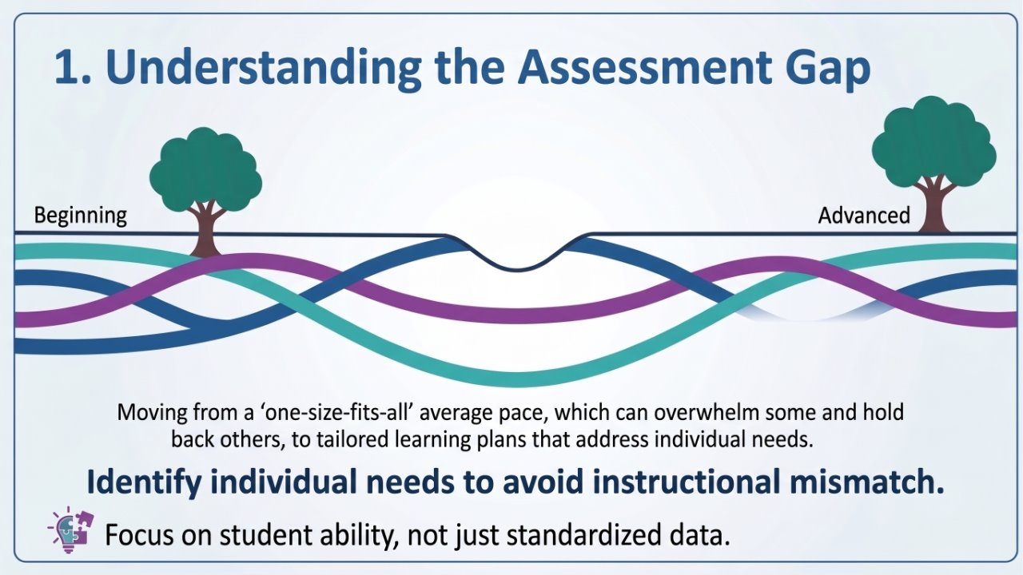
Starting Strong – Why?
Understanding the implementation gap
Kalyuga et al., (2003)

Slide 13
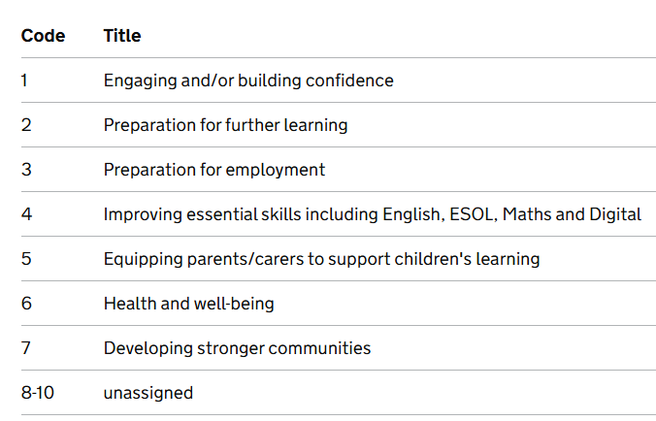
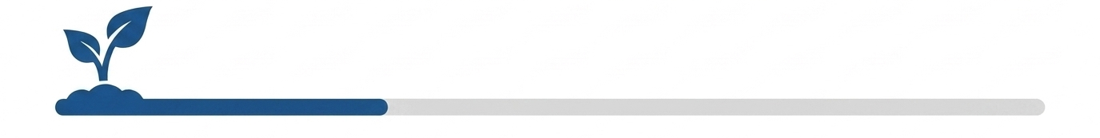
Starting Strong (Adult Curriculum)
Tailored Learning Outcomes
Aligning ALL adult curriculum

Slide 14
Starting Strong (Adult Curriculum)
Align to one (or more) of the outcomes
Initially assess which of these your students want to achieve
Explore wider PD options (other courses)
Measure outcomes
Reflect, adapt, market

Slide 15
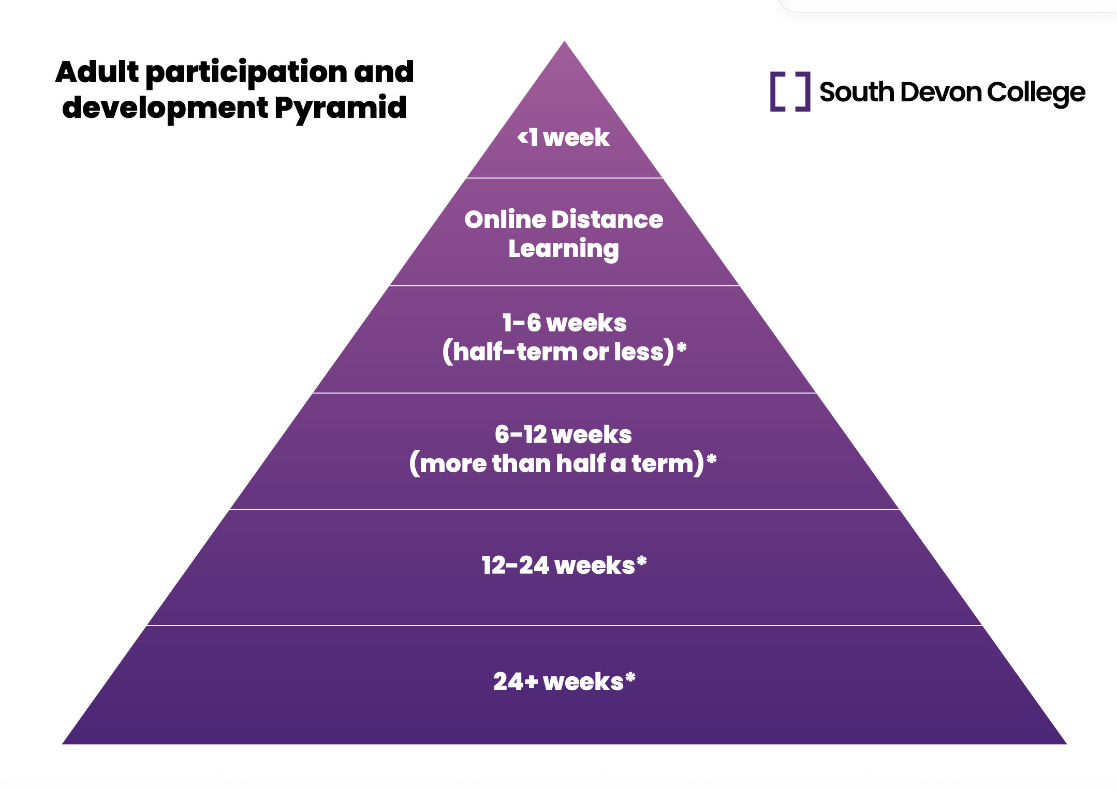
Starting Strong – P & D (Adult Curriculum)
Lead: Maria W

Slide 16
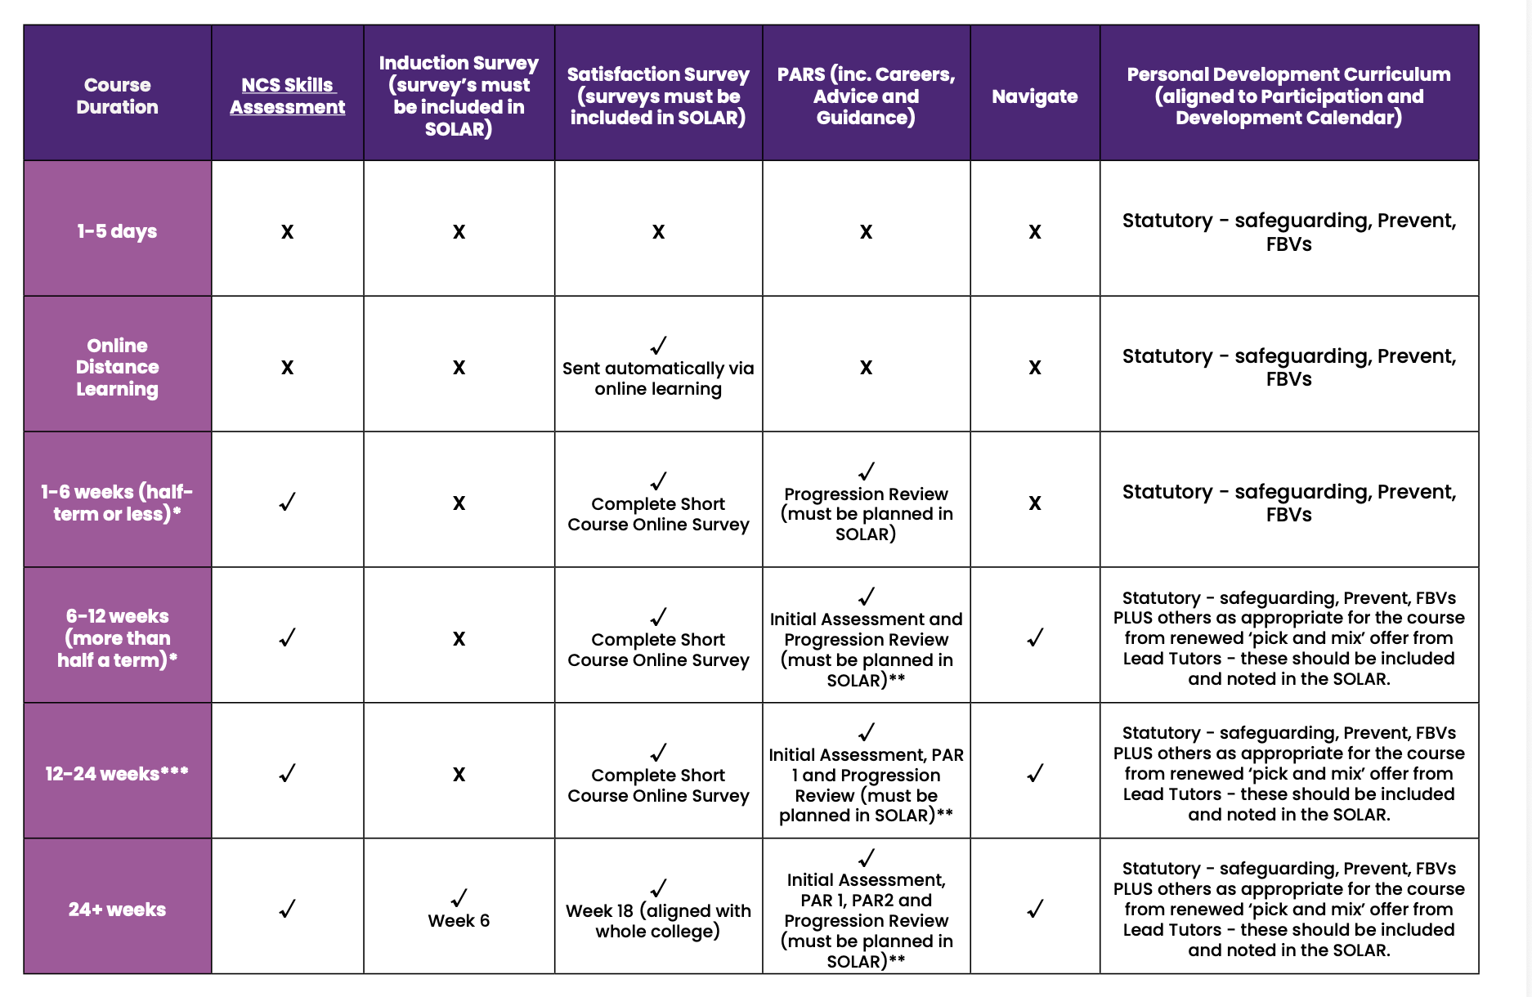
Starting Strong – P & D (Adult Curriculum)
Different requirements for different course lengths!

Slide 17
Starting Strong – How?
What are you doing well/
What could you do to ensure that learners ‘Start Strong?’

Slide 18

Finishing Stronger – What?
(Lead: Darren Bird)
What do we understand by the term finishing stronger?

Slide 19
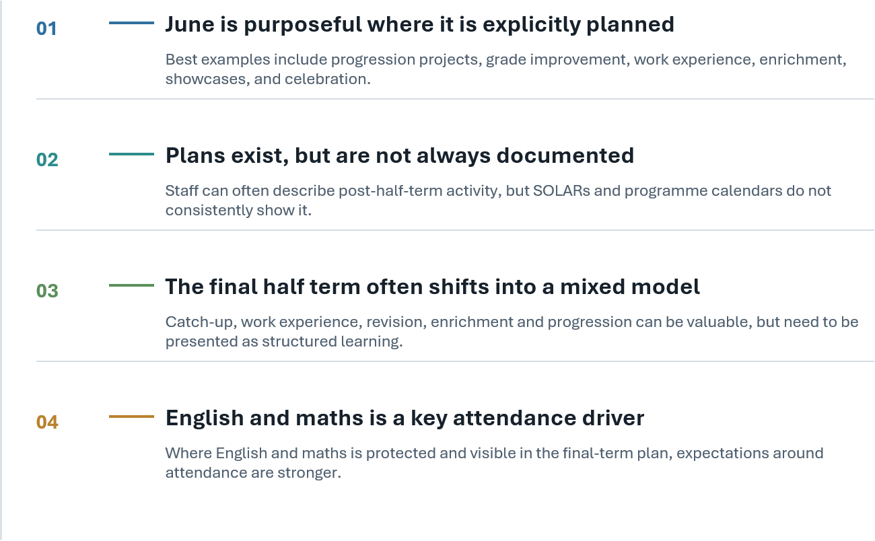
Finishing Stronger
Improvement Focus Area (IFA) 'Finishing Stronger' audit
APR-May 2026

Slide 20
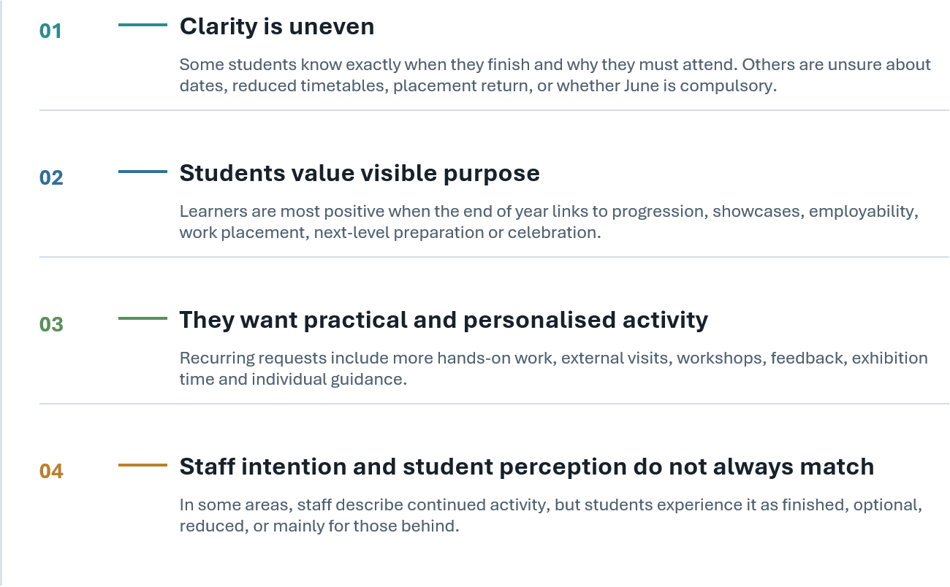
Finishing Stronger
Improvement Focus Area (IFA) 'Finishing Stronger' audit
APR-May 2026

Slide 21
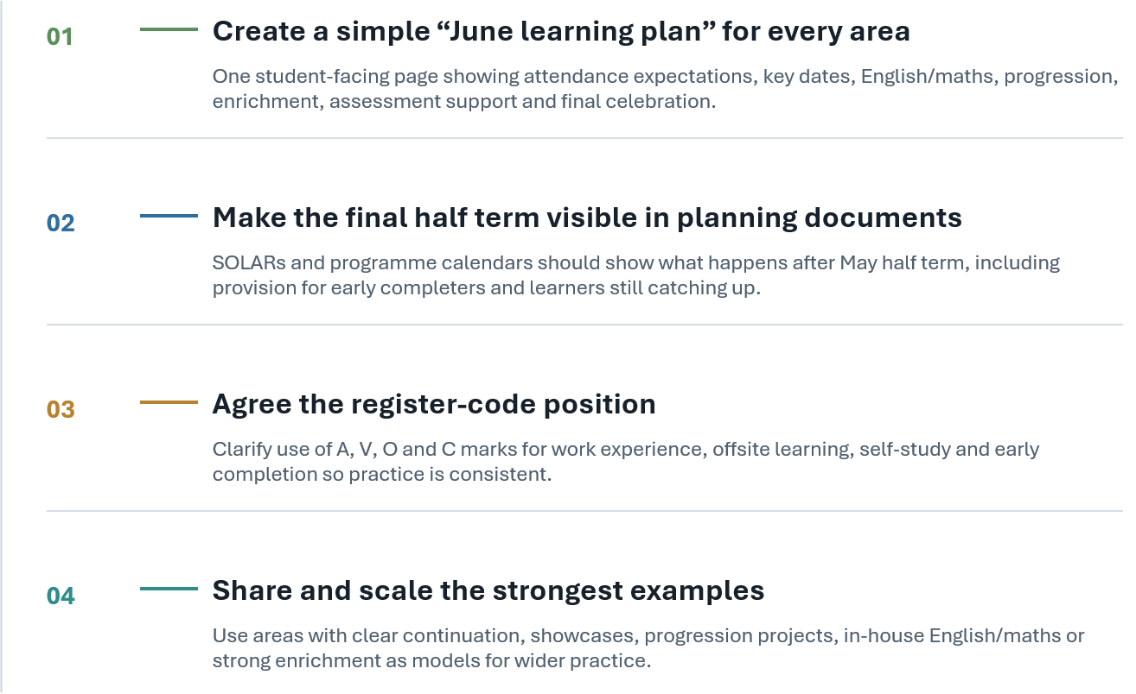
Finishing Stronger
Improvement Focus Area (IFA) 'Finishing Stronger' audit
APR-May 2026

Slide 22
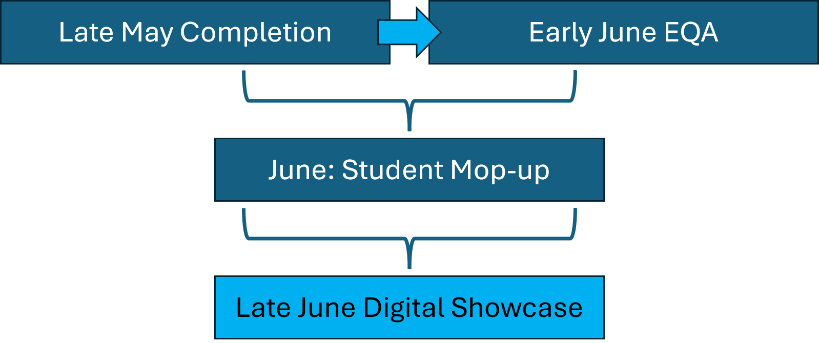

Finishing Stronger – Hi Tech and Digital

Slide 23
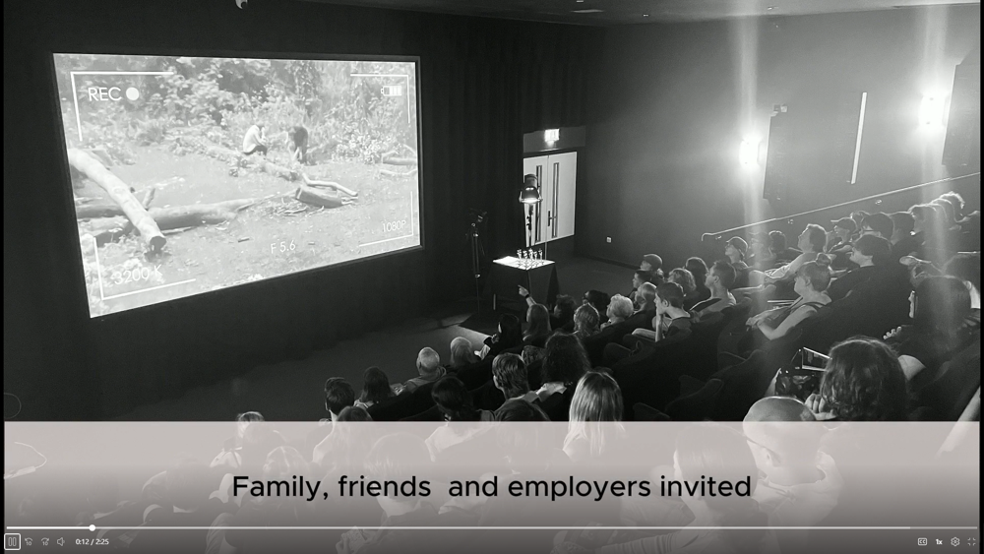
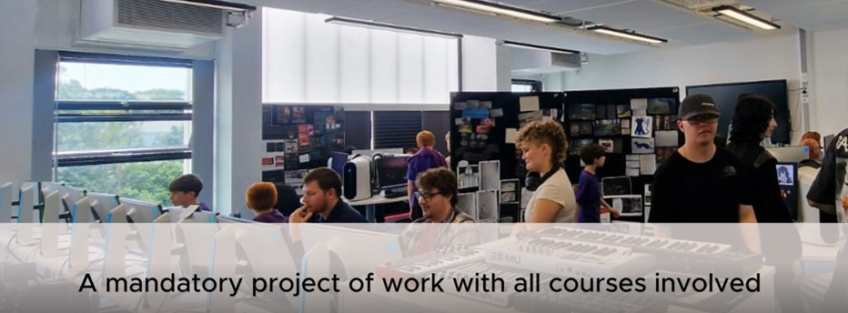
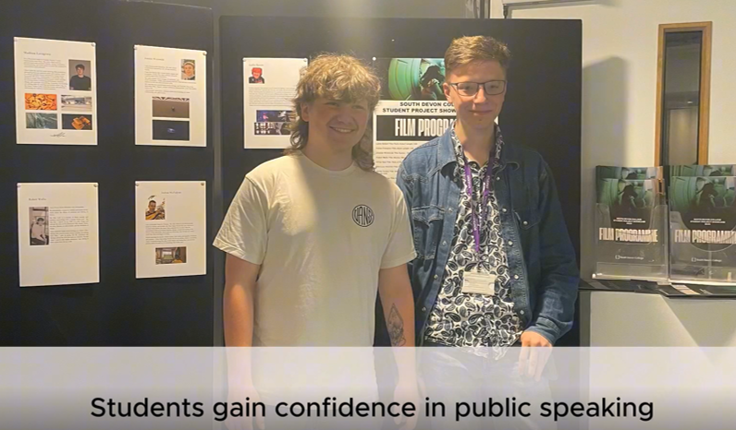
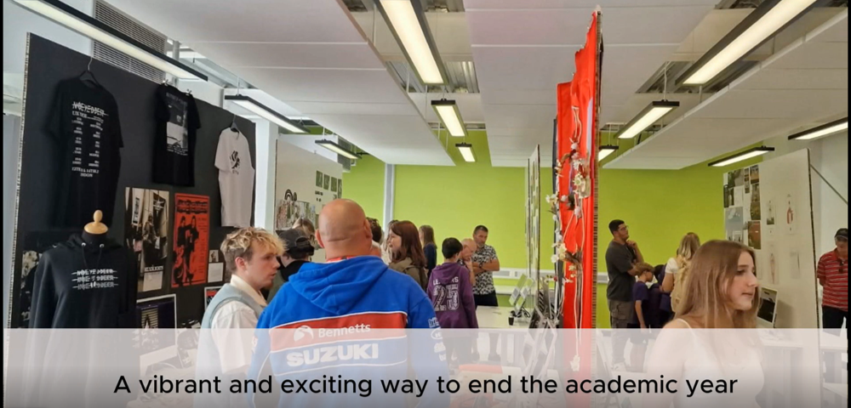
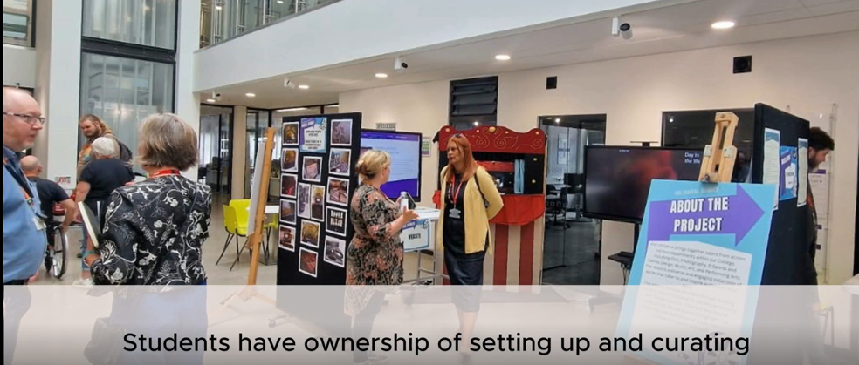
Finishing Stronger – Hi Tech and Digital

Slide 24
Finishing Stronger – Whole College ☺

Slide 25
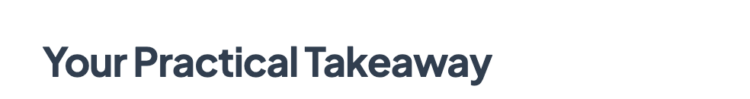
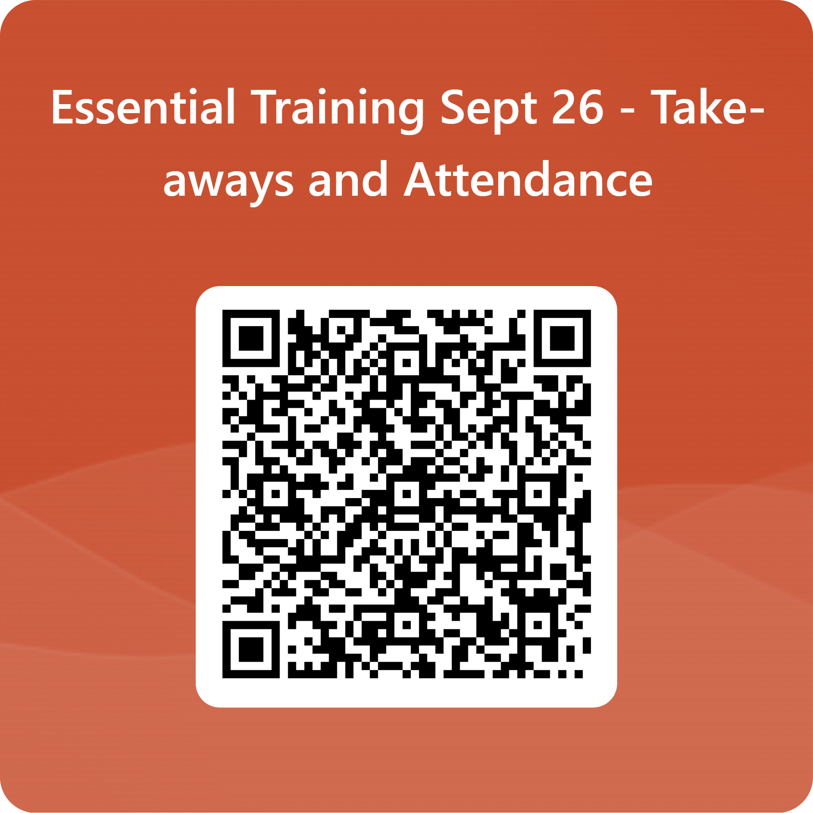

Slide 26
Additional Reading…
Kalyuga, S., Ayres, P., Chandler, P. and Sweller, J. (2003) 'The expertise reversal effect', Educational Psychologist, 38(1), pp. 23–31.
Banerjee, A., Banerji, R., Berry, J., Duflo, E., Kannan, H., Mukherji, S., ... & Walton, M. (2016). Mainstreaming an effective intervention: Evidence from randomized evaluations of “Teaching at the Right Level” in India (No. w22746). National Bureau of Economic Research.

Slide 27
Starting Strong – Why?

Slide 28
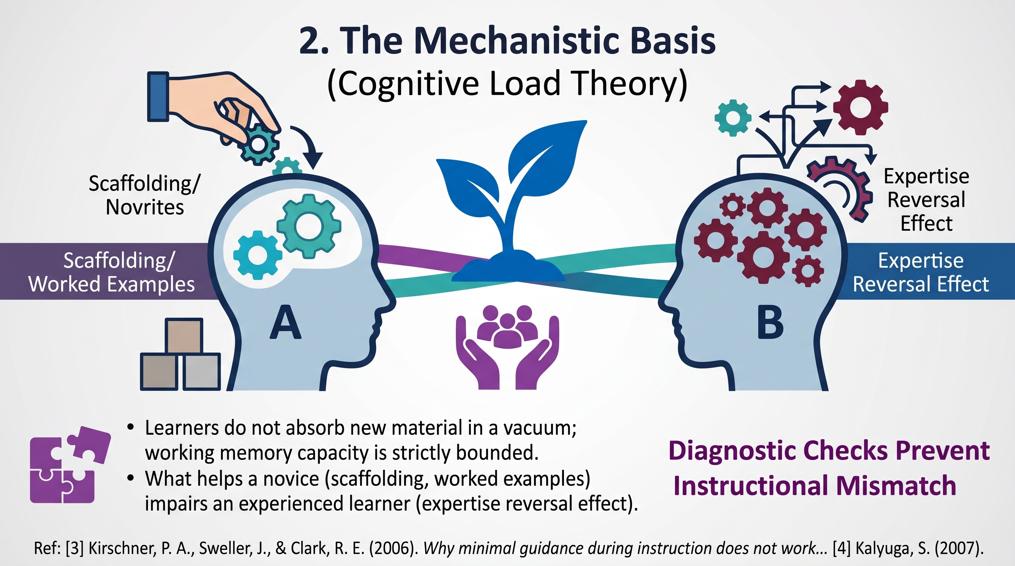
2.
Supporting novices
Impairing ‘experts’

Slide 29
Supporting novices
Impairing ‘experts’

Slide 30
